Slide 1

Twilearn
Data Science Internship

Slide 2

2.) Amazon_Sales_Data id-10
CSV File
Colab
Tableau

Slide 3
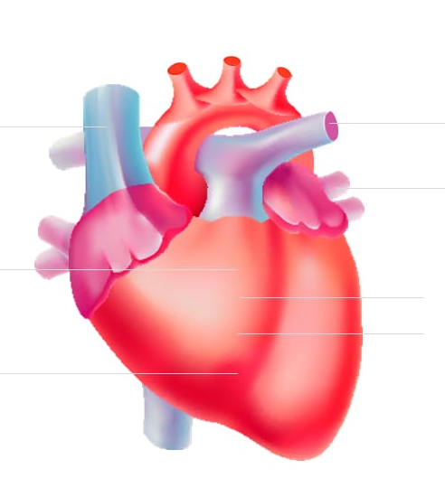
1.) Heart Disease Diagnostic Analysis –id-1
CSV File
colab
Tableau

Slide 4
Thank You By P.Mohan Tarun CRIN2302079

